Slide 1
Introduction to Algorithm Design and Analysis
[L5] Graph Traversal(图遍历)
授课人：黄金贵 (18674880696)
信息科学与工程学院计算机系
2022年春季

Slide 2
Course Contents
optimization problems
Graph traversal
greedy
DP
回溯法、 分枝限界
DFS
BFS
MST
Path (single source)
Path (all-pair)
Dynamic programming
decomposition
graph structure
graph problems

Slide 3
Course Contents
optimization problems
greedy
DP
回溯、分枝限界
DFS BFS
DFS (directed)
DFS (undirected)
MST
Path (single source)
Path (all-pair)
Dynamic programming
graph structure
decomposition
graph problems

Slide 4
主要内容：
图概述
图的深度优先遍历DFS
有向图DFS应用
无向图DFS应用
图的广度优先遍历BFS
BFS应用

Slide 5
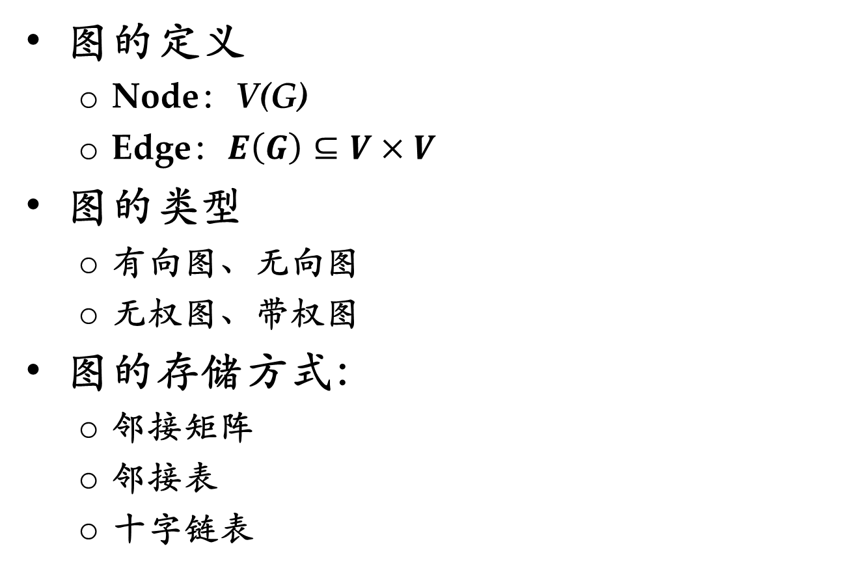
Graph Basics
图的定义
Node：V(G)
Edge：$E\left(G\right)⊆V×V$
图的类型
有向图、无向图
无权图、带权图
图的存储方式：
邻接矩阵
邻接表
十字链表

Slide 6
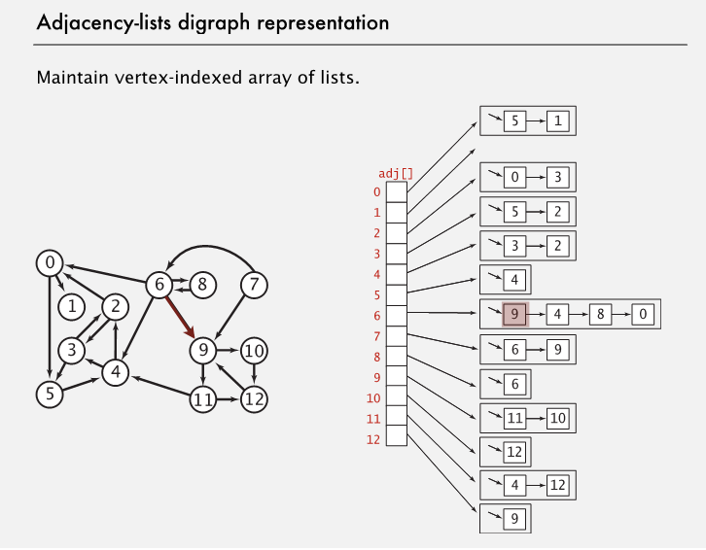
邻接表

Slide 7
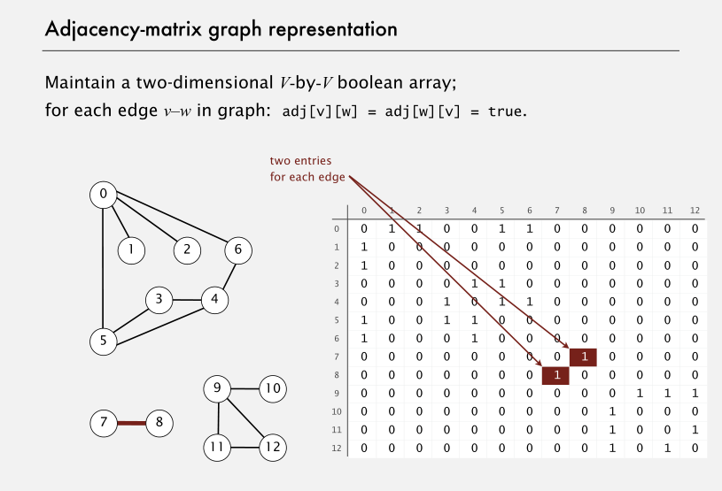
邻接矩阵
Directed vs. Undirected graphs

Slide 8
Graph Traversal
Starting node
A
D
Not reachable
B
G
Breadth-First Search
Starting node
F
C
E
A
D
Depth-First Search
B
G
Edges only “checked”
F
C
E
Not reachable
Notes:
人点上留，人在边上走
DFS：递归；BFS：队列

Slide 9
Depth-First Search -DFS
深度优先搜索的过程是：
（1）从图中某个初始顶点v出发，首先访问初始顶点v。
（2）然后选择一个与顶点v相邻且没被访问过的顶点w为初始顶点，再从w出发进行深度优先搜索。
（3）重复直到图中与当前顶点v邻接的所有顶点都被访问过为止。显然，这个搜索过程是个递归过程。
顶点的3种状态：
white：表示结点尚未被访问
gray：表示结点正在被访问
black：表示结点被访问结束

Slide 10
DFS 主程序框架
Input: Graph g（邻接矩阵或邻接表）
Output: Return value depends on application.
int dfsSweep(graph g,int n, …)
int ans;
Color all node WHITE;
For each v in g.V
if ( v.color == WHITE )
int vAns = dfs(g, v, …);
<Process vAns>
return ans;

Slide 11
深度优先搜索算法
void DFS(Graph g,int v) //邻接矩阵的DFS算法
{ v.color = GRAY; //进入访问
<Preorder processing of node v>;
foreach w in g.neighbor(v) //找顶点v的所有相邻点
if (w.color == WHITE)
<Exploratory processing of edge vw>;
DFS(g,w); //找顶点v的未访问过的相邻点w
<Backtrack processing of edge vw>;
else
<Checking edge vw>;
<Postorder processing of node v >
v.color = BLACK;
}
深度优先遍历的时间复杂度为 O(m + n)

Slide 12
Finding Connected Components
Input: a array g[1…n] of adjacency lists.
Output: an array cc[1..n] of component number for each node v_{i}
void FindCC ( adjlist g[], int n, int[] cc) // This is a wrapper procedure
int[] color = new int[n+1];
<Initialize color array to white for all vertices>
int v;
for (v=1; v≤n; v++)
if (color[v]==white)
ccDFS(g, color, v, v, cc); //Depth-first search
return

Slide 13
ccDFS: the procedure
void ccDFS(g, color[], v, ccNum, cc[])
//v as the code of current connected component
int w;
adjList remAdj=g[v]; //顶点v的邻居列表
color[v]=gray;
cc[v] = ccNum; //连通分支号
while (remAdj ≠ nil)
w = first(remAdj);
if (color[w] == white)
ccDFS(g, color, w, ccNum, cc);
remAdj = rest(remAdj);//处理下一个邻居（如果存在）
color[v] = black; //顶点v处理完成。
return
the time complexity is in Θ(m+n)， Extra space requirements:….

Slide 14
Depth-first Search Trees
DFS forest={(DFS tree1), (DFS tree2)}
Root of tree 1
B.E
D
A
B.E
T.E
T.E
C.E
D.E
B
C.E
G
T.E
T.E
B.E
T.E
F
C
E
C.E
C.E
Root of tree 2
TE: TreeEdge(树边)
BE: BackEdge(返回边)
DE: DescendantEdge(后继边)
CE: CrossEdge(交叉边)
A finished vertex is never revisited, such as C

Slide 15
Active Interval(活动区间)
1/10
5/6
time
B.E
D
A
B.E
T.E
2/7
T.E
C.E
12/13
white
gray
black
D.E
B
C.E
G
T.E
T.E
B.E
finishTime
discoverTime
T.E
F
C
E
8/9
C.E
C.E
The relations are summarized in the next frame
3/4
11/14
Time
1 2 3 4 5 6 7 8 9 10 11 12 13 14
A
E
B
F
G
C
D

Slide 16
Depth-First Search Trace
int dfsTraceSweep(IntList[] adjV,int n)
color[n] = white;
int ans; int time=0;
int[] discoverTime;
int[] finishTime;
int[] parent;
For (i=0;i<=n;i++)
v = adjV[i];
if (color[v] == white)
parent[v]=-1 //v无父结点
int vAns=dfsTrace(adjV, color, v, discoverTime,
finishTime, parent, time );
return ans;

Slide 17
int dfsTrace(intList[ ] adjV, int[ ] color, int v,
int[] discoverTime, int[] finishTime, int[] parent int time)
int w; int ans;
color[v] = gray;
IntList remAdj=adjVertices[v];
time++; discoverTime[v]=time;
while (remAdj ≠ nil)
w = first(remAdj);
if (color[w]==white)
parent[w]=v;
int wAns=dfsTrace(adjV, color, w, discoverTime,
finishTime, parent, time);
else
<Checking for nontree edge vw>
remAdj = rest(remAdj);
time++; finishTime[v]=time;
color[v]=black;
return ans;

Slide 18
Properties of Active Intervals
w是v在DFS树中的后继结点,当且仅当
active(w) ⊆ active(v)。
若 w ≠ v，则此处的包含为真包含。
w和v没有祖先后继关系，当且仅当active(w)和active(v)没有重叠。
如果vw是图G中的边，则
vw is a cross edge iff. active(w) entirely precedes active(v).
vw is a descendant edge iff. there is some third vertex x, such that active(w) ⊂ active(x) ⊂ active(v),
vw is a tree edge iff. active(w) ⊂ active(v), and there is no third vertex x, such that active(w) ⊂ active(x) ⊂ active(v),
vw is a back edge iff. active(v) ⊂ active(w).

Slide 19
Ancestor and Descendant 祖先和后继
That w is a descendant of v in the DFS forest means that there is a direct path from v to w in some DFS tree.
The path is also a path in G.
However, if there is a direct path from v to w in G, is w necessarily a descendant of v in the DFS forest?
v_{k}
undiscovered
checked
v_{k+2}
v_{k+1}
At the moment before backtracking
v_{k+3}

Slide 20
For Your Reference
tree edge
back edge
starting vertex
cross edge
v₁
A DFS tree partially formed at the moment the search checking v₃ from v₆
tree edge not accessed yet
v₄
v₂
descendant edge not accessed yet
v₅
v₃
v₆
white path
Now, here
v₇
v₈
* Note: v₄ is reachable from v₆, and is white, but it is not a descendant of v₆

Slide 21
有向图上深度优先遍历的应用
Directed Acyclic Graph（DAG，有向无环图）
Topological order（拓扑排序）
Critical path analysis（关键路径）
Strongly Connected Component (SCC，强连通分支)
Strong connected component and condensation
The algorithm
Leader of strong connected component

Slide 22
Directed Acyclic Graph (DAG)
3
3
2
4
2
4
1
5
1
5
6
9
6
9
7
8
7
8
A Directed Acyclic Graph
Not a DAG

Slide 23
Topological Order for G=(V,E)
Topological number
An assignment of distinct integer 1,2,…, n to the vertices of V
For every vw∈E, the topological number of v is less than that of w.
Reverse topological order
Defined similarly (“greater than” )
8
3
7
4
9
2
3
1
5
2
6
9
4
1
7
8
5
6

Slide 24
Existence of Topological Order – a Negative Result
If a directed graph G has a cycle, then G has no topological order
Proof
[By contradiction]
3
2
4
y
yx-path
1
5
xy-path
For any given topological order, all the vertices on both paths must be in increasing order. Contradiction results for any assignments for x and y.
6
9
x
7
8

Slide 25
Reverse Topological Ordering（逆拓扑排序）
G has a topological ordering, iff. G is a directed acyclic graph.
拓扑排序的存在性可通过构造算法来证明。
Specialized parameters（算法参数说明）
数组topo[]：记录每个顶点在拓扑排序中赋予的一个整数。
整数计数器topoNum： 提供整数累加用于赋给顶点的拓扑排序。
Output（算法输出）
Array topo as filled.

Slide 26
Reverse Topological Ordering
void dfsTopoSweep(IntList[ ] adjV, int n, int[] topo)
global int topoNum = 0；
//Allocate color array and initialize to white
for (v=0;v<n;v++) color[v]=white;
//DFS
for (v=0;v<n;v++)
if (color[v]==white)
dfsTopo(adjV, color, v, topo, topoNum);
// Continue loop
return;

Slide 27
Reverse Topological Ordering －Algorithm
void dfsTopo(IntList[] adjV, int[] color, int v,
int[] topo)
int w; color[v]=gray;
IntList remAdj=adjV[v];
while (remAdj ≠ nil)
w=first(remAdj);
if (color[w]==white)
dfsTopo(adjV, color, w, topo);
remAdj=rest(remAdj);
topoNum++;
topo[v] = topoNum
color[v]=black;
return;
Obviously, in Θ(m+n)

Slide 28
Reverse Topological Ordering
For an “end node”
Easy to decide
Acyclic
There is always an end
Everyone becomes an end
B
structural end
…
A
C
structural end
logical end
(when B,C,D finished)
D
structural end

Slide 29
Correctness of the Algorithm
If G is a DAG with n vertices, the procedure dfsTopoSweep computes a reverse topological order for G in the array topo.
Proof
The procedure dfsTopo is called exactly once for a vertex, so, the numbers in topo must be distinct in the range 1,2,…n.
For any edge vw, vw can’t be a back edge(otherwise, a cycle is formed). For any other edge types, we have
finishTime(v) > finishTime(w),
so, topo(w) is assigned earlier than topo(v). Note that topoNum
is incremented monotonically, so,
topo(v) > topo(w).

Slide 30
Task Scheduling 任务调度
Problem:
Scheduling a project consisting of a set of interdependent tasks to be done by one person.
Solution:
Establishing a dependency graph, the vertices are tasks, and edge vw is included iff. the execution of v depends on the completion of w,
Making task scheduling according to the topological order of the graph(if existing).
v
任务v依赖任务w
w

Slide 31
Task Scheduling: an Example
Tasks(No.) Depends on
-------------------------------
choose clothes(1) 9
dress(2) 1,8
eat breakfast(3) 5,6,7
leave(4) 2,3
make coffee(5) 9
make toast(6) 9
pour juice(7) 9
shower(8) 9
wake up(9) -
The DAG
9/16/8
5/8/4
3
17/18/9
2
4
1/4/2
10/11/5
1
5
6
9
12/13/6
2/3/1
7
8
A reverse topological order
9, 1, 8, 2, 5, 6, 7, 3, 4
14/15/7
6/7/3
Start time/finish time/topo #

Slide 32
Project Optimization Problem
Assuming that parallel executions of tasks (v_{i}) are possible except for prohibited by interdependency.
Observation
In a critical path, v_{i-1}, is a critical dependency of v_{i}, i.e. any delay in v_{i-1}will result in delay in v_{i}.
The time for entire project depends on the time for the critical path.
Reducing the time of a off-critical-path task is of no help for reducing the total time for the project.
The problems
Find the critical path in a DAG
(Try to reduce the time for the critical path)
This is a precondition.

Slide 33
Critical Path in a Task Graph
Earliest start time(est) for a task v
If dependencies(v)==empty, then est[v]= 0;
Else,est[v]=maximum{eft[u]|u∈dependencies(v)}.
Earliest finish time(eft) for a task v
For any task: eft[v] = est[v] + duration[v]
Critical path in a project is a sequence of tasks: v₀, v₁, …, v_{k}, satisfying:
v₀ has no dependencies;
For any v_{i}(i=1,2,…,k), v_{i-1} is a dependency of v_{i}, such that est of v_{i} equals eft of v_{i-1};
eft of v_{k}, is maximum for all tasks in the project.

Slide 34
DAG with Weights
eat: 6
3
leave: 1
Critical Path
dress: 6.5
2
4
Critical Subpath
choose: 3
coffee: 4.5
1
1
5
3
0
toast: 2
8
2
6
9
0
8.5
wake:0
6.5
juice: 0.5
8
7
5
shower: 8.5
0
4.5
9
1
done
6
4
0
2
6.0
0
3
7
0.5

Slide 35
Critical Path Finding - DFS
Specialized parameters(算法参数说明)
Array duration, keeps the execution time of each vertex.
Array critDep, keeps the critical dependency of each vertex.
Array eft, keeps the earliest finished time of each vertex.
Output
Array critDep, eft as filled.
Critical path is built by tracing the output.

Slide 36
Critical Path – Case 1
est(v) to be updated
v
eft(w) known
对于树边(TE)vw回溯处理:
if eft[w] ≥ est[v]
est[v] = eft[w];
critDep[v]=w;
eft[v] = est[v]+duration[v];
backtraking
w
just finished

Slide 37
Critical Path – Case 2
根据交叉边（CE）vw处理:
if eft[w] ≥ est[v]
est[v] = eft[w];
critDep[v]=w;
eft[v] = est[v]+duration[v];
c
eft(w) known
w
finished
(Why?)
checking
v
est(v) to be updated

Slide 38
Critical Path by DFS
void dfsCritSweep(IntList[] adjV, int n）
int[] duration；
int[] critDep；
int[] eft；
<Allocate color array and initialize to white>
For each vertex v of G, in some order
if (color[v] == white)
dfsCrit(adjV,color,v,duration, critDep, eft);
// Continue loop
return critDep, eft;

Slide 39
Critical Path by DFS
void dfsCrit(.. adjV, .. color, .. v, int[] duration, int[ ] critDep, int[ ] eft)
int w; int est=0;
color[v]=gray; critDep[v]=-1;
IntList remAdj = adjV[v];
while (remAdj ≠ nil)
w=first(remAdj);
if (color[w] == white)
dfsCrit(adjV,color,w,duration, critDep, eft);
else
<checking for nontree edge>
if (eft[w]≥est) est = eft[w]; critDep[v]=w;
remAdj=rest(remAdj);
eft[v]=est+duration[v];
color[v]=black;
return;
Only black vertex

Slide 40
Analysis of Critical Path Algorithm
Correctness:
When eft[w] is accessed in the while-loop, the w must not be gray(otherwise, there is a cycle), so, it must be black, with eft initialized.
According to DFS, each entry in the eft array is assigned a value exactly once. The value satisfies the definition of eft.
Complexity
Simply same as DFS, that is Θ(n+m).

Slide 41
SCC: Strongly Connected Component 强连通分支
A
D
Condensation Graph G↓
B
G
ABDF
EG
F
C
E
C
Graph G
3 Strongly Connected Components
It’s acyclic, Why?
Note: two SCC in one DFS tree

Slide 42
Transpose Graph(转置图)
Condensation Graph G↓
A
D
B
G
ABDF
EG
F
C
E
C
Tranpose Graph G^{T}
Connected Components unchanged according to vertices
But, DFS tree changed

Slide 43
Basic Idea - G
C₁
Reverse topo order for leader finish time: C₁, C4, C₂, C₃
C₄
C₂
C₃
C₁
C₄
C₂
C₃
a DFS tree with 4 connected components, depicted as a condensation
Original edge

Slide 44
Basic Idea - G^{T}
C₁
Transposed edge
C₄
Original Graph
C₂
C₃
C₁
C₄
C₂
C₃
a DFS tree with 4 connected components, depicted as a condensation

Slide 45
SCC - An Example
D
A
D
A
B
B
G
G
F
C
E
F
C
E
A
D
A
D
transposed
B
G
B
G
F
C
E
F
C
E
C D B F A G E
push/pop

Slide 46
Strong Component Algorithm: Outline
void SCC(IntList[] adjV, int n, int[] scc)
//Phase 1
1. IntStack finishStack=create(n);
2. Perform a depth-first search on G, using the DFS skeleton. At postorder（后序） processing for vertex v, insert the statement: push(finishStack, v)
//Phase 2
3. Compute G^{T}, the transpose graph, represented as array adjTrans of adjacency list.
4. dfsTsweep(adjTrans, n, finishStack, scc);
return

Slide 47
Strong Component Algorithm: Core
void dfsTsweep(IntList[] adjTrans, int n, IntStack finishStack, int[] scc)
<Allocate color array and initialize to white>
while (finishStack is not empty)
int v=top(finishStack);
pop(finishStack);
if (color[v]==white)
dfsT(adjTrans, color, v, v, scc);
return;
void dfsT(IntList[] adjTrans, int[] color, int v, int leader, int[] scc)
Use the standard depth-first search skeleton. At postorder processing for vertex v insert the statement:
scc[v]=leader;
Pass leader and scc into recursive calls.

Slide 48
Leader of a Strong Component
For a DFS, the first vertex discovered in a strong component S_{i} is called the leader of S_{i} .
Each DFS tree of a digraph G contains only complete strong components of G, one or more.
Proof: Applying White Path Theorem whenever the leader of S_{i} (i=1,2,…p) is discovered, starting with all vertices being white.
The leader of S_{i} is the last vertex to finish among all vertices of S_{i}. (since all of them in the same DFS tree)

Slide 49
Path between SCCs
The leader of S_{i}
At discovering
x can’t be gray.
White case: v_{i}x-path is a White Path, or
Black case: x is black (consider the [possible] last non-white vertex z on the v_{i}x-path)
v_{i}
S_{i}
S_{j2}
What’s the color?
Existing a yv_{i}-path, so x must be in a different strong component.
No v_{i}y-path can exist.
z
x
y
S_{j1}
See Lemma 7.8 & 7.9 p. 360 of [Baase01]
Gray

Slide 50
C₁ : The End Case
Looking at C₂, C₃ from C₁
G
G^{T}
C₁
C₁
C₁
C₂
C₃
C₂
C₃
C₂
C₃

Slide 51
C₂ : The White Case
Looking at C₃ from C₂
G
G^{T}
C₁
C₁
C₁
C₂
C₃
C₂
C₃
C₂
C₃

Slide 52
C₂ : The Black Case
Looking at C₃ from C₂
G
G^{T}
C₁
C₁
C₁
C₂
C₃
C₂
C₃
C₂
C₃

Slide 53
Active Intervals
If there is an edge from S_{i} to S_{j}, then it is impossible that the active interval of v_{j} is entirely after that of v_{i}. (Note: for leader v_{i} only)
There is no path from a leader of a strong component to any gray vertex.
If there is a path from the leader v of a strong component to any x in a different strong component, v finishes later than x.

Slide 54
Correctness of Strong Component Algorithm (1)
In phase 2, each time a white vertex is popped from finishStack, that vertex is the Phase 1 leader of a strong component.
The later finished, the earlier popped
The leader is the first to get popped in the strong component it belongs to
If x popped is not a leader, then some other vertex in the strong component has been visited previously. But not a partial strong component can be in a DFS tree, so, x must be in a completed DFS tree, and is not white.

Slide 55
Correctness of Strong Component Algorithm (2)
In phase 2, each depth-first search tree contains exactly one strong component of vertices
Only “exactly one” need to be proved
Assume that v_{i}, a phase 1 leader is popped. If another component S_{j} is reachable from v_{i} in G^{T}, there is a path in G from v_{j} to v_{i}. So, in phase 1, v_{j} finished later than v_{i}, and popped earlier than v_{i} in phase 2. So, when v_{i} popped, all vertices in S_{j} are black. So, S_{j} are not contained in DFS tree containing v_{i}(S_{i}).

Slide 56
DFS on Undirected Graph 无向图中的应用
Biconnected Components
Articulation Points（割点）
Bridge（桥）

Slide 57
Biconnected Graph
Being connected
Tree: acyclic, least (cost) connected
Node/edge connected: fault-tolerant connection
Articulation point (2-node connected)割点
v is an articulation point if deleting v leads to disconnection
Bridge (2-edge connected)桥
uv is a bridge if deleting uv leads to disconnection

Slide 58
Articulation Point Algorithm
Ancestors of v
v 是割点当且仅当在以w为根的子树中 不存在到v的祖先结点的返回边。
v
如果v是分支上距离根最远的割点，则检测到一个2-点连通分支。
w
Subtree rooted at w
Back edge(返回边)

Slide 59
Updating the value of back
v 首次被发现时（first discovered）：
back = discoverTime(v)
从 v 遍历其邻居遇到返回边 vw 时：
back = min(back, discoverTime(w))
从 w 回溯到 v 时：
back = min(back, w.back)
The back value of v is the smallest discover time a back edge “sees” from any subtree of v.

Slide 60
寻找割点的Example
second back edge encountered
G
G
I
I
5/5
B
B
C
C
E
E
6/6
4/4
3/3
3/1
H
F
J
H
F
J
A
D
A
D
2/2
1/1
2/2
1/1
first back edge encountered

Slide 61
Example
G
8/8
9/9
backtracking
G
third back edge
encountered
I
I
5/4
B
5/4
B
C
C
E
6/4
4/4
E
6/4
4/4
3/1
3/1
H
F
J
H
F
J
A
D
A
D
1/1
2/2
1/1
2/2

Slide 62
Example
8/5
8/5
G
9/5
G
9/5
backtracking:
G.back = discoverTime(B)，
so, first bicomponent detected.
I
backtracking
I
5/4
5/4
B
B
C
C
E
6/4
E
6/4
4/4
4/4
3/1
3/1
H
F
J
H
F
J
A
D
A
D
1/1
2/2
1/1
2/2

Slide 63
Keeping the Track of Backing
Tracking data
For each vertex v, a local variable back is used to store the required information, as the value of discoverTime of some vertex.
Testing for bicomponent
从 w 回溯到 v 时, 如果有:
w.Back ≥ discoverTime(v)
则找到一个2-连通分支且 v是割点。
when back is no less than the discover time of v, there is at least one subtree of v connected to other part of the graph only by v.

Slide 64
Example
8/5
G
9/5
Backtracking from B to E:
b.Back=discoverTime(E),
so, the second bicomponent is detect
I
5/4
B
C
E
6/4
4/4
14/1
3/1
16/2
H
F
J
Backtracking from E to F:
e.Back>discoverTime(F),
so, the third bicomponent is detect
A
D
1/1
2/2

Slide 65
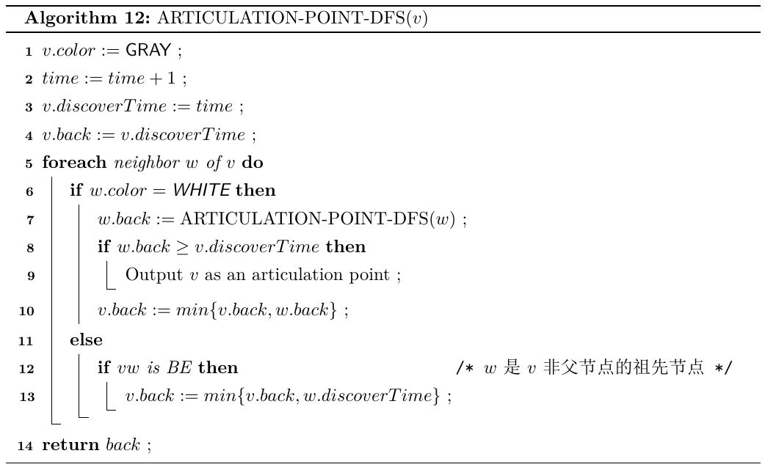
Articulation Point Algorithm

Slide 66
Correctness 割点算法的正确性
算法判定规则
考虑树边vw，当从w回溯到v时，若有：
w.Back ≥ discoverTime(v)
则v是割点。
假设以w为根的子树中存在某个结点x有到v的祖先y的回边，则根据算法有：
w.back = min{w.back, x.back } = x.back
x.back = discovertime(y)
discovertime(y) < discovertime(v)
所以： w.back < discovertime(v)
割点v所在的子树中没有到v的祖先的回边。

Slide 67
Characteristics of Articulation Point
In a DFS tree, a vertex(not root) v is an articulation point if and only if (1)v is not a leaf; (2) some subtree of v has no back edge incident with a proper ancestor of v.
⇐ Trivial
⇒
By definition, v is on every path between some x,y(different from v).
At least one of x,y is a proper descendent of v(otherwise, x↔root↔y not containing v).
By contradiction, suppose that every subtree of v has a back edge to a proper ancestor of v, we can find a xy-path not containing v for all possible cases(only 2 cases)

Slide 68
Case 1
Case 1.2: another is an ancestor of v
Case 1.1: another is not an ancestor of v
suppose that every subtree of v has a back edge to a proper ancestor of v, and, exactly one of x, y is a descendant of v.
y
v
y
v
x
x

Slide 69
Case 2
suppose that every subtree of v has a back edge to a proper ancestor of v, and, both x, y are descendants of v.
v
y
x

Slide 70
What about the root?
One single DFS tree
We only consider each connected component
Root AP ≡ Two or more sub-tree
The root is an articulation point
Not an articulation point
Is an articulation point

Slide 71
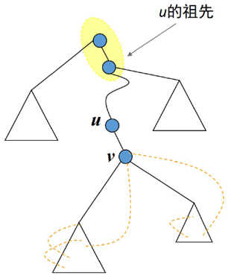
Defining the Bridge
Short definition
Removing uv leading to disconnection
Long definition
Edge uv is a bridge iff node u and v are connected only by uv
DFS Definition
Edge uv is a tree edge in DFS
There is no subtree rooted at v to any proper ancestor of v (including u)
Ancestor of u

Slide 72
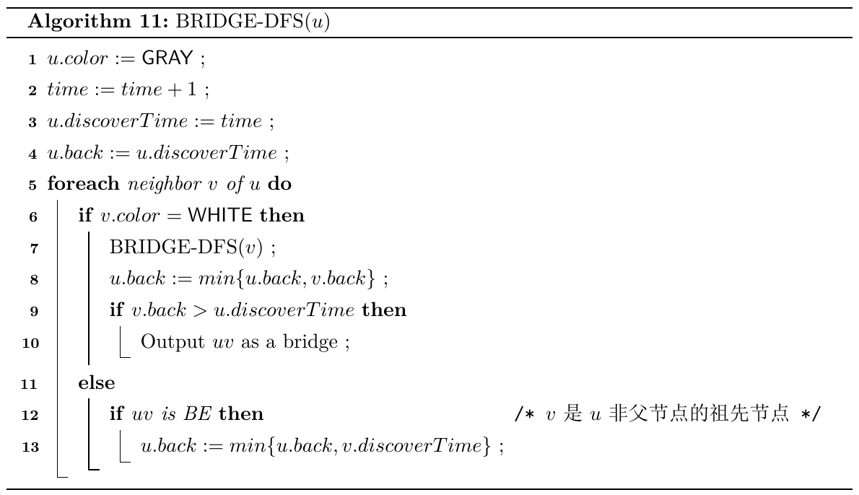
Bridge Algorithm

Slide 73
Graph Traversal
Starting node
A
D
Not reachable
B
G
Breadth-First Search
Starting node
F
C
E
A
D
Depth-First Search
B
G
Edges only “checked”
F
C
E
Not reachable
Notes:
人点上留，人在边上走
DFS：递归；BFS：队列

Slide 74
Breadth-First Search--BFS
广度优先搜索的过程是：
（1）首先访问初始顶点v。
（2）接着访问顶点v的所有未被访问过的邻接点v₁，v₂，…，v_{t}。
（3）然后再按照v₁，v₂，…，v_{t}的次序，访问每一个顶点的所有未被访问过的邻接点，依次类推，直到图中所有和初始顶点v有路径相通的顶点都被访问过为止。

Slide 75
BFS主程序框架
Input: graph G
Output: Return value depends on application.
void bfsSweep(graoh g,int n, …)
int ans;
int visted[n]=0;
For each vertex v of G, in some order
if (visted[v]==0)
void bfs(g, v, …);
<Process vAns>
return;

Slide 76
以邻接矩阵为图的存储结构，采用广度优先搜索图时，需要使用一个队列。
int visited[MAXV]=0; //定义存放结点的访问标志的数组
void BFS(MGraph g,int v) //邻接矩阵的BFS算法
{ queue<int> qu; //定义一个队列qu
int w,i;
visited[v]=1; //置已访问标记
qu.push(v); //v进队
while (!qu.empty()) //队列不空时循环
{ w = qu.pop(); //出队顶点w
for (i=0;i<g.n;i++) //找与顶点w相邻的顶点
if (g.edges[w][i]!=0 && visited[i]==0)
{ //若当前邻接顶点i未被访问
<<对该结点的处理操作>>
visited[i]=1; //置该顶点已被访问的标志
qu.push(i); //该顶点进队
}
}
}

Slide 77
以邻接表为图的存储结构，采用广度优先搜索图时，需要使用一个队列。
int visited[MAXV]=0; //定义存放结点的访问标志的数组
void BFS(ALGraph *G,int v) //邻接表的BFS算法
{ ArcNode *p;
queue<int> qu; //定义一个队列qu
visited[v]=1; //置已访问标记
qu.push(v); //v进队
while (!qu.empty()) //队列不空时循环
{ w=qu.pop(); //出队顶点w
p=G->adjlist[w].firstarc; //找顶点w的第一个邻接点
while (p!=NULL)
{ if (visited[p->adjvex]==0) //若当前邻接顶点未被访问
{ <<对该结点的处理操作>>
visited[p->adjvex]=1; //置该顶点已被访问的标志
qu.push(p->adjvex); //该顶点进队
}
p=p->nextarc; //找顶点w的下一个邻接点
}
}
}

Slide 78
DFS vs. BFS Search
Processing opportunities for a node
Depth-first: 2
At discovering
At finishing
Breadth-first: only 1, when de-queued
At the second processing opportunity for the DFS, the algorithm can make use of information about the descendants of the current node.
时间复杂度：O(m+n)

Slide 79
BFS的应用
判断二分图
寻找k度子图
求最大团
连通图最短路径

Slide 80
判断二分图
初始化：所有顶点都置为白色;
bool BFS-Bipartie(Graph g，vertex v) //判断图g是否为二分图
queue<int> qu; //定义一个队列qu
v.color = Red;
qu.push(v); //顶点u进队
while (!qu.empty()) //队不空时循环
w = qu.pop(); //出队顶点w
p = g->adjlist[w].firstarc; //找w的第一个邻接点
while (p!=NULL)
if (p->color == White )
p->color = ¬w->color; // ¬Blue=Red
qu.push(p); //将w的邻接点进队
elseif (p->color == w->color )
return False
p=p->nextarc; //找w的下一个邻接点
return True

Slide 81
寻找k度子图
bool k-degreeSubgraph(Graph g，int k) //寻找图g的k度子图
queue<int> qu; //定义一个队列qu并初始化为空
初始化顶点加入队列标记
for each v in g
if (v.degree < k)
v.visited = 1;
qu.push(v); //顶点v进队
while (!qu.empty()) //队不空时循环
v = qu.pop(); //出队顶点v
for each w in v.neighbor
删除边wv;
if (w.degree < k && w.visited==0)
w.visited = 1;
qu.push(w); //将w进队
删除顶点v;
return 图g是否不为空。

Slide 82
【例】假设图G采用邻接表存储，设计一个算法，求不带权无向连通图G中从顶点u到顶点v的一条最短路径。
解：图G是不带权的无向连通图，一条边的长度计为1，因此，求顶点u和顶点v的最短路径即求距离顶点u到顶点v的边数最少的顶点序列。
利用广度优先遍历算法，从u出发一层一层地向外扩展，扩展到某个顶点时记录其前驱顶点，当第一次找到顶点v时队列中便隐含从顶点u到顶点v最近的路径，再利用队列输出最短路径。
u
v
path

Slide 83
void ShortPath(ALGraph *G,int u,int v,vector<int> &path)
//求图G中从顶点u到顶点v的最短（逆）路径path
queue<int> qu; //定义一个队列qu
int pre[MAXV]; //表示前驱关系
int visited[MAXV]=0; //定义存放顶点的访问标志的数组
qu.push(u); //顶点u进队
visited[u]=1;
pre[u]=-1; //起始顶点的前驱置为-1
while (!qu.empty()) //队不空时循环
w=qu.pop(); //出队顶点w
if (w==v) //找到v时输出路径之逆并退出
Findpath(pre,v,path);
return;
p=G->adjlist[w].firstarc; //找w的第一个邻接点
while (p!=NULL)
if (visited[p->adjvex]==0)
visited[p->adjvex]=1; //访问w的邻接点
qu.push(p->adjvex); //将w的邻接点进队
pre[p->adjvex]=w; //设置p->adjvex顶点的前驱为w
p=p->nextarc; //找w的下一个邻接点

Slide 84
求解迷宫问题
【问题描述】有如下8*8的迷宫图：
OXXXXXXX
OOOOOXXX
XOXXOOOX
XOXXOXXO
XOXXXXXX
XOXXOOOX
XOOOOXOO
XXXXXXXO
其中，O表示通路方块，X表示障碍方块。假设入口是位置（0，0），出口为右下角方块位置（7，7）。设计一个程序采用递归方法求指定入口到出口的一条迷宫路径。

Slide 85
【问题求解】用n表示迷宫大小，二维数组Maze存放迷宫，从（x，y）方块可以试探上下左右4个方位，假设总是从方位0到方位3的顺序试探，各方位对应的水平方向偏移量H[4] = {0，1，0，-1}，垂直偏移量V[4] = {-1，0，1，0}。
(x,y-1)
(x-1,y)
(x,y)
(x+1,y)
(x,y+1)

Slide 86
解法1：采用深度优先遍历方式，从（x，y）出发（初始为入口）搜索目标（出口）。
对于当前方块（x，y）：
需要试探4个相邻的方块。
为了避免重复，每走过一个方块，将对应的迷宫值由'O'改为' '（空字符），当回过来时将其迷宫值恢复为'O'。

Slide 87
#include <stdio.h>
#define MAxN 10 //最大迷宫大小
//问题表示
int n=8; //迷宫大小
char Maze[MAxN][MAxN]=
{ {'O','X','X','X','X','X','X','X'},
{'O','O','O','O','O','X','X','X'},
{'X','O','X','X','O','O','O','X'},
{'X','O','X','X','O','X','X','O'},
{'X','O','X','X','X','X','X','X'},
{'X','O','X','X','O','O','O','X'},
{'X','O','O','O','O','X','O','O'},
{'X','X','X','X','X','X','X','O'}
};
int H[4] = {0, 1, 0, -1}; //水平偏移量,下标对应方位号0～3
int V[4] = {-1, 0, 1, 0}; //垂直偏移量

Slide 88
void DFS(int x,int y) //求从(x,y)出发的一条迷宫路径
{ if (x==n-1 && y==n-1) //找到一条路径,输出
{ Maze[n-1][n-1]=' ';
disppath();
return;
}
else
{ for (int k=0;k<4;k++) //试探每一个方位
if(x>=0 && y>=0 && x<n && y<n && Maze[x][y]=='O')
{ //若(x,y)方块的可走的
Maze[x][y]=' '; //将该方块迷宫值设置为空字符
DFS(x+V[k],y+H[k]); //查找(x,y)周围的每一个相邻方块
Maze[x][y]='O';
//若从该相邻方块出发没有找到路径,恢复(x,y)迷宫值
}
}
}

Slide 89
求解结果
↓XXXXXXX
→↓OOOXXX
X↓XXOOOX
X↓XXOXXO
X↓XXXXXX
X↓XX→→↓X
X→→→↑X→↓
XXXXXXX√

Slide 90
解法2：采用广度优先遍历方式，从（x，y）出发（初始为入口）搜索目标（出口）。由于STL中queue不能顺序遍历，这里采用一个数组作为非循环队列，front和rear分别为队头和队尾（初始时均设置为-1），每个进队元素有唯一的下标。
队列元素类型声明如下：
struct Position //队列元素类型
{ int x,y; //当前方块位置
int pre; //前驱方块的下标
};

Slide 91
（1）将根入口方块（其pre置为-1）进队。
（2）队列不空循环：
出队方块p1作为当前方块（在队列数组中的下标为front）：
若为p1出口：通过队列数组qu反向推出迷宫路径并输出。
否则：查找p1的每一个相邻方块p2，若p2位置有效（即p2.x>=0 && p2.y>=0 && p2.x<n && p2.y<n）并且可走（Maze[p2.x][p2.y]='O'），则置p2.pre=front（表示p2的前驱方块是p1）并将p2方块进队。
front
p1
p2.pre=front
p2

Slide 92
//问题表示
int n=8; //迷宫大小
char Maze[MAxN][MAxN]=
{ {'O','X','X','X','X','X','X','X'},
{'O','O','O','O','O','X','X','X'},
{'X','O','X','X','O','O','O','X'},
{'X','O','X','X','O','X','X','O'},
{'X','O','X','X','X','X','X','X'},
{'X','O','X','X','O','O','O','X'},
{'X','O','O','O','O','X','O','O'},
{'X','X','X','X','X','X','X','O'}
};
int H[4] = {0, 1, 0, -1}; //水平偏移量,下标对应方位号0～3
int V[4] = {-1, 0, 1, 0}; //垂直偏移量
struct Position //队列元素类型
{ int x,y; //当前方块位置
int pre; //前驱方块的下标
};
Position qu[MAXQ]; //定义一个队列qu
int front=-1,rear=-1; //定义队头和队尾

Slide 93
void BFS(int x,int y) //求从(x,y)出发的一条迷宫路径
{ Position p,p1,p2;
p.x=x; p.y=y; p.pre=-1; //建立入口结点
Maze[p.x][p.y]='*'; //改为'*'避免重复查找
rear++; qu[rear]=p; //入口方块进队
while (front!=rear) //队不空循环
{ front++; p1=qu[front]; //出队方块p1
if (p1.x==n-1 && p1.y==n-1) //找到出口
{ disppath(front); //输出路径
return;
}
for (int k=0;k<4;k++) //试探p1的每个相邻方位
{ p2.x=p1.x+V[k]; //找到p1的相邻方块p2
p2.y=p1.y+H[k];
if (p2.x>=0 && p2.y>=0 && p2.x<n && p2.y<n
&& Maze[p2.x][p2.y]=='O')
{ //方块p2有效并且可走
Maze[p2.x][p2.y]='*'; //改为'*'避免重复查找
p2.pre=front;
rear++; qu[rear]=p2; //方块p2进队
}
}
}
}

Slide 94
Thank you!
Q & A

